Slide 1
NewHope University Intelligent Search
Presented By:
PEACE MIRIYA SAMUEL
OLAMIDE LANRE
ILUOBE ROMEO THOMAS
ABDULLAHI IDRIS ABDULLAHI
ALIYU SANI
BASHIR USMAN SAULAWA
OBINEZE, COLLINS C.

Slide 2
"Google's job is to get you off Google as fast as possible.“ (Sergey Brin)

Slide 3
Introduction
Introduction to NewHope University: NewHope University is a beacon of academic excellence and innovation, molding future leaders through its dedication to quality education and research.
Knowledge Nexus: NewHope University's academic database houses comprehensive info about esteemed staff. This includes personal profiles, achievements, history, research, and taught courses.
Importance of Effective Search: In the era of information, swift and accurate data access is crucial. A refined academic staff database with efficient search capabilities unlocks NewHope University's wealth of knowledge.
Empowering Exploration: A strong search system not only streamlines operations but also empowers staff and students to delve into NewHope University's vibrant academic landscape.

Slide 4
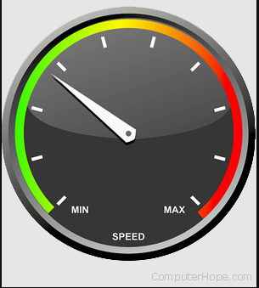

Current System Limitations
Performance Challenges: As data gets bigger, system gets slow. Handling lots of data is hard, makes it slow to respond, affects user experience. This can disrupt quick school tasks.
Inefficient Search: The existing academic staff database suffers from inefficiencies in search capabilities. Queries take longer to process, resulting in slower retrieval of information. This hampers the ability to swiftly access essential data, leading to potential delays in decision-making and research endeavors.
Limited Query Power: System lacks advanced searches. No indexes, complex searches not possible. Users can't search keywords or close words, important for efficient info finding.
Complex Data Entry: No easy interface, hard to put info. Staff without SQL skills struggle with input and retrieval. This makes profiles outdated, affects operations.

Slide 5
Vision for Improvement
Implementing Indexes: We're going to upgrade how we search by adding something called "indexes." Imagine a big book with special tabs that help you quickly find exactly what you're looking for. In our system, these indexes will guide us to information faster, making our searches smarter and quicker.
Full-Text Search: Ever wished you could find a specific word in a long story? Think of our system as a magic magnifying glass for words. It'll let us search through big documents and find those important words, just like finding a needle in a haystack.
User-Friendly Web Interface: We're making things super easy with a new way to put information and find what we need. Imagine colorful buttons on a screen that make everything simple. You won't need to know any secret computer codes – it's like using a friendly map to navigate.

Slide 6


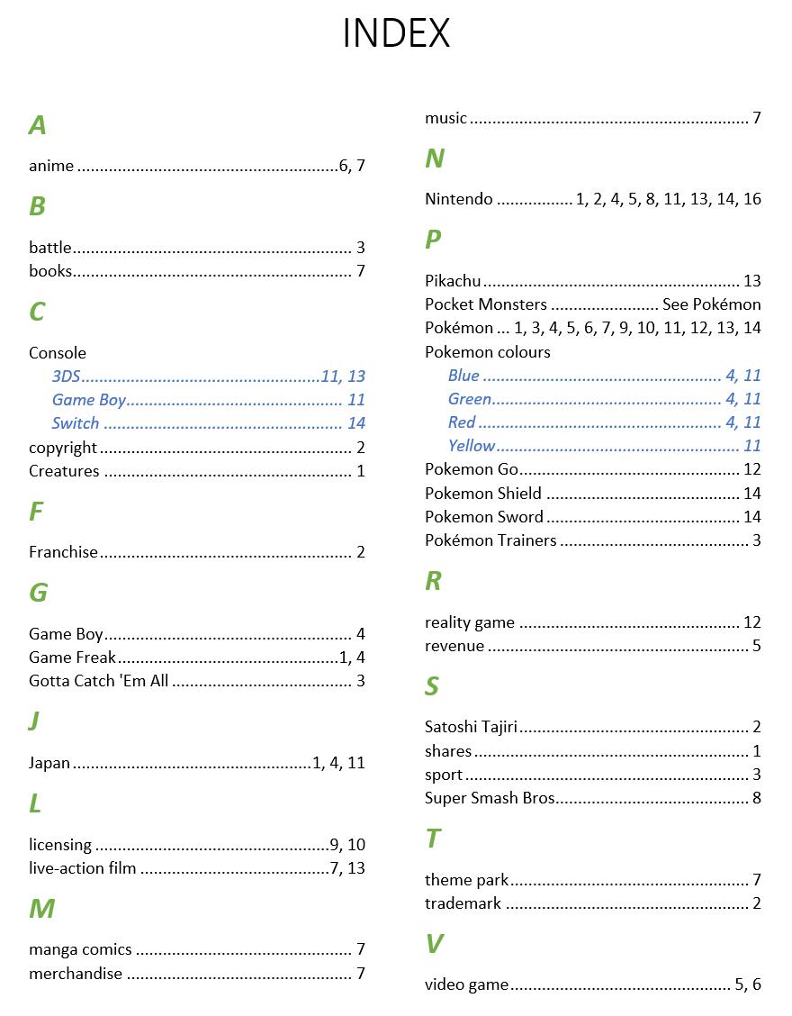
BOOK INDEXING

Slide 7
Indexes Implementation
Selecting Columns: We choosed specific parts of the data, like names or subjects, to create indexes. This helps the system find things faster. Choosing specific columns for indexing is based on frequently used search criteria, commonly joined columns, frequently sorted columns, and high data cardinality, aiming to enhance query performance without overloading the database with unnecessary indexes.
CREATE INDEX index_nameON table_name (column1, column2, ...);
index_name: Name of the index you want to create.
table_name: Name of the table on which you want to create the index.
column1, column2, ...: Names of the columns for which you want to create the index.
T-SQL syntax for creating an index in SQL Server

Slide 8
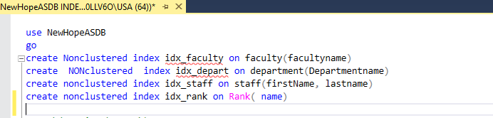
Speeding Up Searches: Indexes act like signposts, telling the system where to look. When we search, the system follows these signposts and finds information quickly, like using a map to find a treasure.

Slide 9
Full-Text Search Integration
Integrating Full-Text Search: We're infusing our system with a remarkable ability – full-text search. This means our system will not only read but also understand the content within documents, just like we do.
Implementing in SQL Server:
Enable Full-Text Search: Turn on full-text search on the database.
Create Full-Text Catalog: Build a catalog that organizes words.
Add Full-Text Index: Select columns in the table that need full-text search.
Use CONTAINS or FREETEXT: In queries, use these special functions to perform full-text searches.

Slide 10


FULLTEXT SEARCH

Slide 11
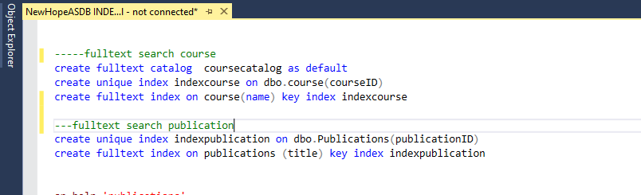
These lines of SQL code work together to establish a full-text search capability for the "course" table. The process involves creating a full-text catalog to hold full-text indexes, creating a unique index to maintain course ID uniqueness, and finally, creating a full-text index on the "name" column for efficient text-based searches. The linkage between the full-text index and the unique index helps ensure accurate and fast search results.

Slide 12
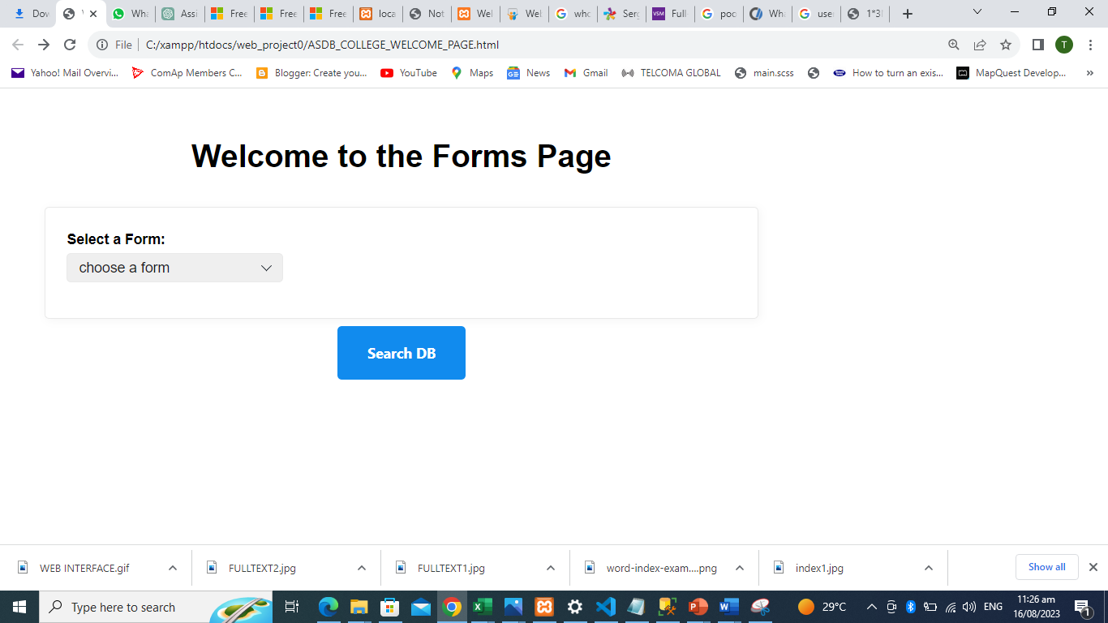
Web Interface Design
In this phase of our project, we've developed a user-friendly web interface that transforms the way users interact with the academic staff database. Our interface is thoughtfully designed to provide an effortless and intuitive experience for both data entry and information retrieval. Below visuals capture the essence of our design philosophy, showcasing the harmonious blend of aesthetics and usability.

Slide 13
WEB INTERFACE

Slide 14
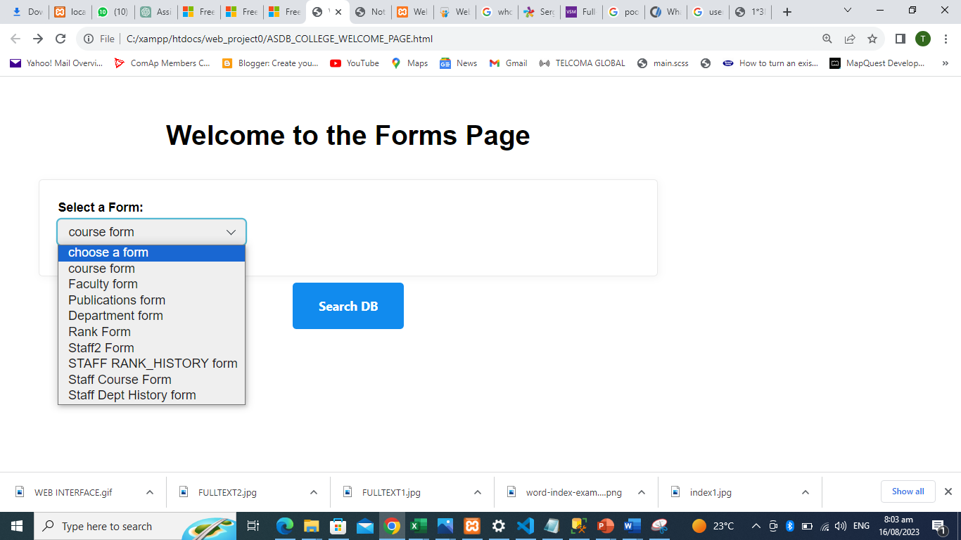
Web Interface Design

Slide 15
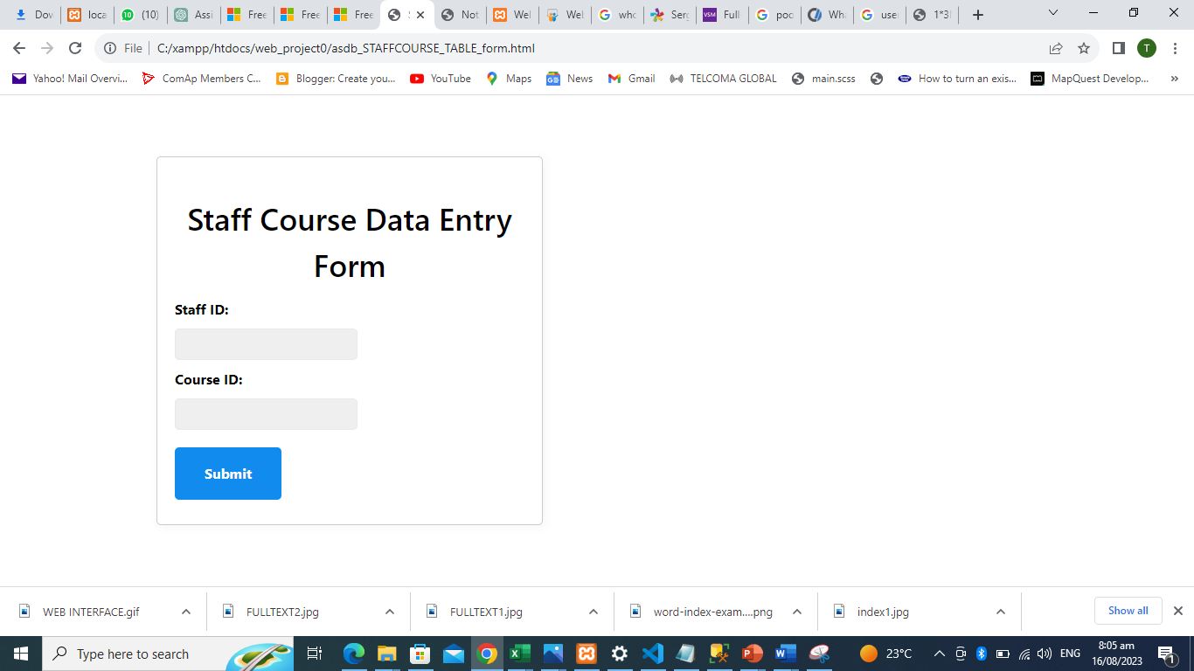
Web Interface Design

Slide 16
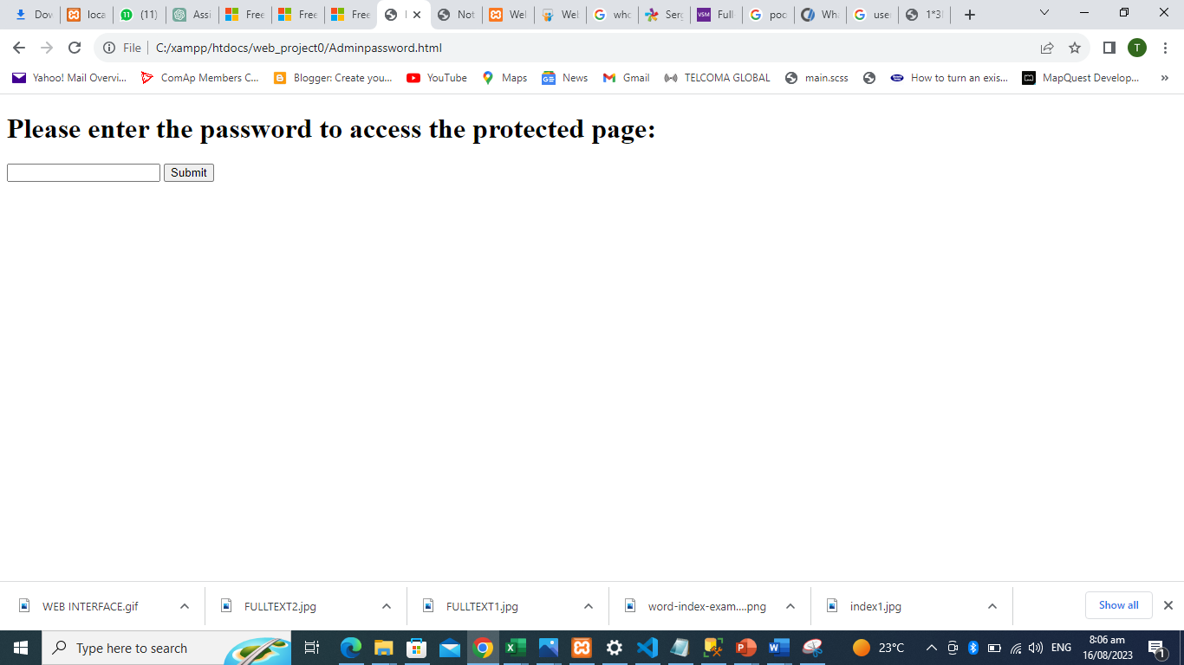
Web Interface Design

Slide 17
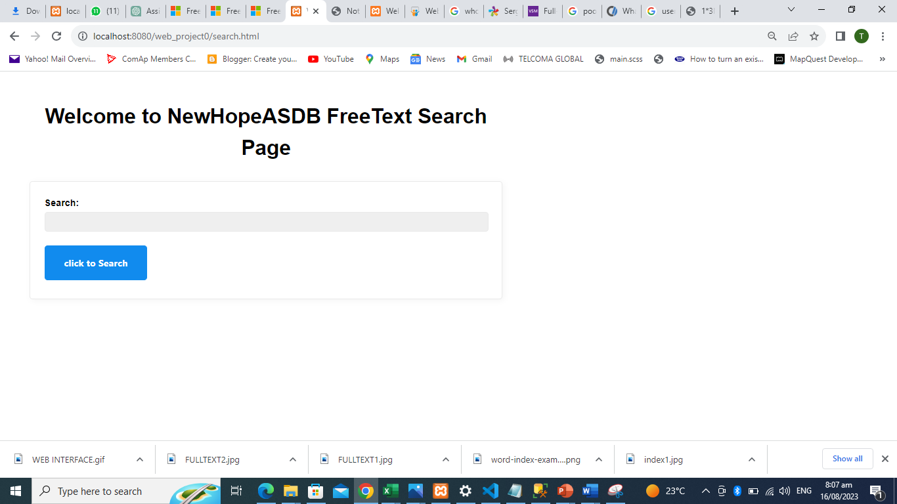
Web Interface Design

Slide 18
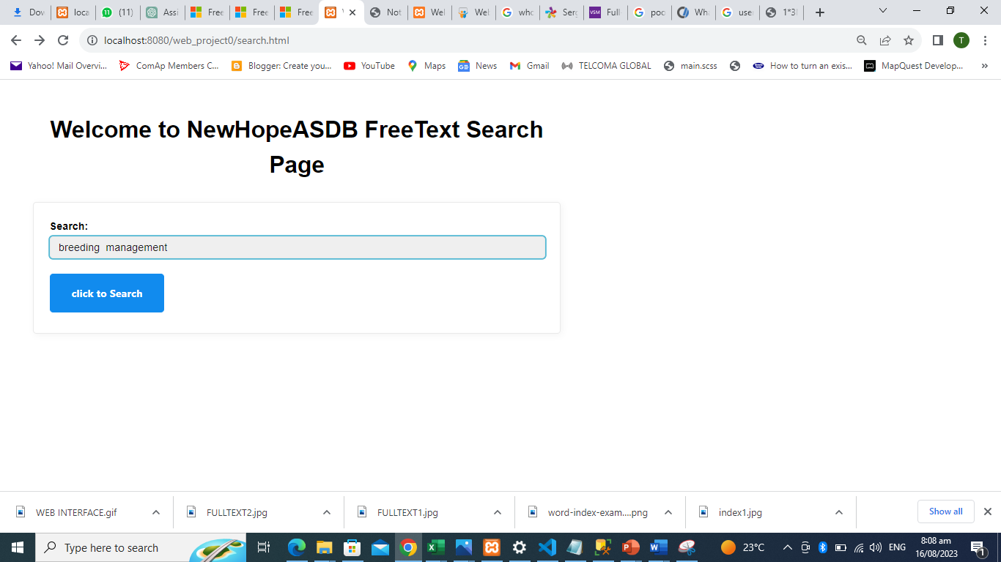
Web Interface Design

Slide 19
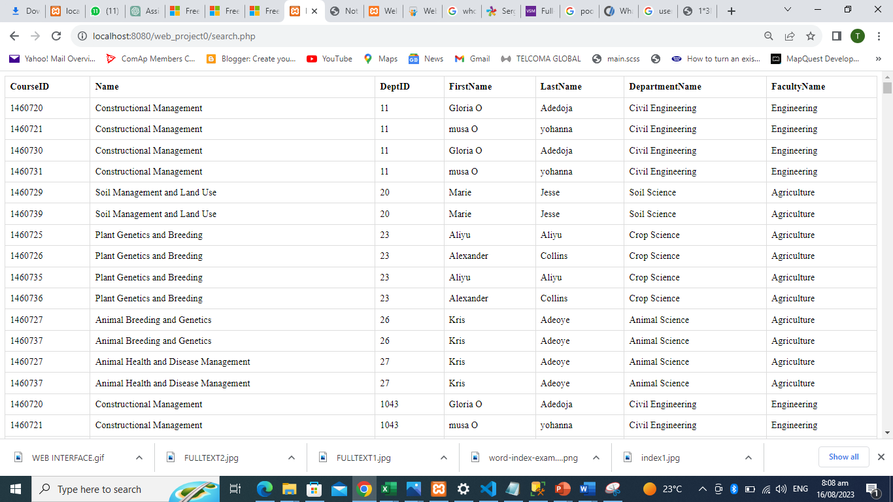
Web Interface Design

Slide 20
Advantages of Web Interface, Full-Text Search, and Index
Advantages of Web Interface | Benefits of Full-Text Search | Benefits of Index Implementation
Simplified data entry process | Quick and accurate search results | Faster search operations
Enhanced user experience | Comprehensive searches across profiles | Improved query performance
Accessibility for users without SQL knowledge | Improved user experience | Enhanced data retrieval efficiency

Slide 21
Project Implementation
Our project's execution involved a systematic approach that leveraged cutting-edge technologies and strategic steps. We carefully orchestrated the implementation of indexes, full-text search, and the user-friendly web interface to enhance the NewHope Universtiy staff database.
Technologies Utilized:
Database Management System: Microsoft SQL Server
Web Development Tools: HTML, CSS, JavaScript
Server-Side Scripting: PHP
Web Server: XAMPP with sqlsvr extension enabled
Planning and Design
Web Interface Development
Index Implementation
Full-Text Search Integration
Testing and Refinement

Slide 22
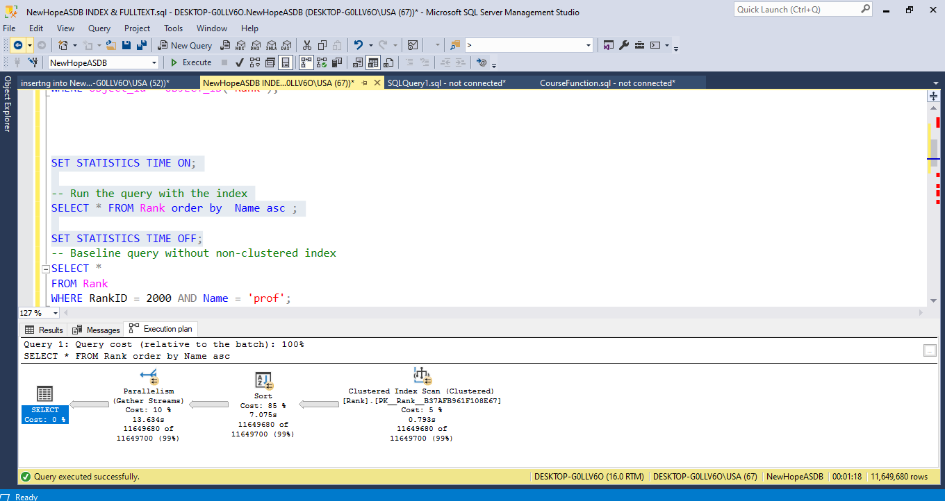
Results and Performance
NOT INDEXED

Slide 23
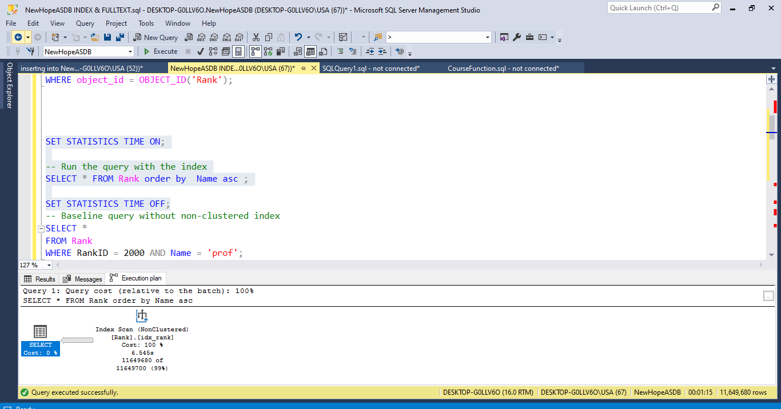
Results and Performance
INDEXED

Slide 24
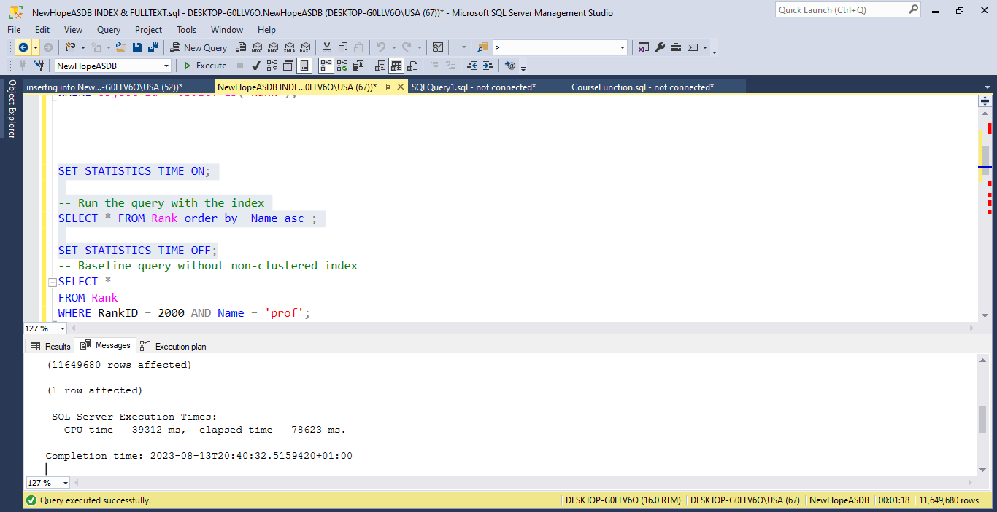
Results and Performance
NOT INDEXED

Slide 25

Results and Performance
INDEXED

Slide 26
Results and Performance
Metric | Without Nonclustered Index | With Nonclustered Index | Difference (Seconds) | Advantage
CPU Time (ms) | 39312 | 8515 | 30.80 | Significantly Faster: CPU time reduced by 30.80 seconds, leading to quicker processing.
Elapsed Time (ms) | 78623 | 74956 | 3.67 | Enhanced Efficiency: Elapsed time reduced by 3.67 seconds, optimizing overall speed.

Slide 27
Future Enhancements
As part of our commitment to continuous improvement, here are some potential enhancements that could further elevate the system's capabilities:
Integration with Other University Systems: We envision seamless collaboration by integrating our enhanced system with other university platforms, fostering a unified ecosystem that maximizes efficiency and data sharing.
Expanding Search Scope: We plan to enhance search capabilities by extending the search location to encompass the entire database table. This expansion will provide users with a more comprehensive search experience, facilitating the discovery of relevant information.
Further Improvements to the Web Interface: We aim to empower users by introducing advanced filtering options to the web interface. This enhancement will allow users to refine their searches based on specific criteria, streamlining the retrieval of precise information.
These potential future enhancements reflect our dedication to evolving technology and meeting the ever-growing needs of NewHope University.

Slide 28
Conclusion
In conclusion, our journey has illuminated the significance of optimizing database search capabilities within NewHope University's academic ecosystem. Through the implementation of indexes, full-text search functionality, and a user-friendly web interface, we have realized substantial benefits that extend far beyond mere technological improvements.
Key Takeaways:
Efficient Database Search: We've underscored the critical role of efficient search capabilities in ensuring rapid and accurate access to vital academic information.
Enhancements' Benefits: The integration of indexes, full-text search, and a user-friendly web interface has led to faster searches, improved accuracy, reduced user frustration, and increased accessibility.
Positive Impact: Our efforts have positively transformed NewHope University's academic staff database, empowering both staff and students to harness the wealth of knowledge it holds.
With these enhancements, we have laid a solid foundation for NewHope University's continuous pursuit of academic excellence and innovation.

Slide 29
THANKS

